Slide 1

CPE 490 Embedded Systems Lecture 14
RTOS Concepts (Text 18.3-18.6)
Much of this presentation comes from www.freertos.org tutorial
As well as “Using the FreeRTOS Real Time Kernal, A Practical Guide”, Richard Barry, 2010 version 1.3.2.

Slide 2
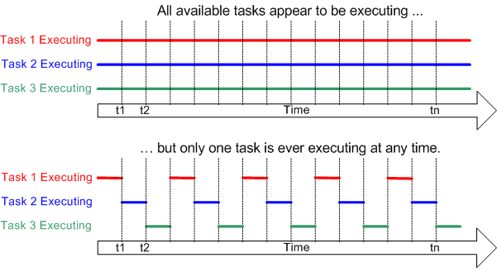
Multitasking
Notes:
Multiple tasks running at the same time through time multiplexing.

Slide 3
Why Multitasking?
Lets you divide up the program into smaller, easier to read, easier to maintain and more manageable tasks.
A task can be verified individually then used in multiple programs, or multiple instances in one program.
Through system architecture the problem can be divided into tasks that multiple people can work on in parallel.
Timing and sequencing of code can be abstracted from the task.

Slide 4
Scheduling Terms
Scheduler: Part of the kernel that decides which task should execute, when, and for how long. The scheduler can start and stop a task numerous times before the task finishes.
Scheduler Policy: The algorithm in the scheduler that is used to “fairly” divide processor time between tasks.
Notes:
Note scheduler in a corporative OS can not stop a task only start it.

Slide 5
RTOS Scheduling
The difference between an OS and RTOS is in the scheduling policy
In a RTOS events must be responded to within a deadline that is set by the context of the program.
For example assume that you must respond to a key press within 100ms and your must sample, filter, and run a control loop every 2 ms with sampling period of 2 ms ±.5 ms having to be maintained

Slide 6
Cyclic with Non-Preemptive Policy
Non-Preemptive – every task runs till completion
Idea can be used with more complicated policies than cyclic
Cyclic scheduling – tasks run in order given in a cycle
Cyclic Scheduling – Tasks 1, 2, and 3 execute in Turn
Notes:
This is very close to the super loop ideas that we talked about

Slide 7
Round Robin with Preemptive Policy
Preemptive – task is stopped before completion, context is saved, and another task can be run.
Idea is not only used in round robin policy
Round Robin – every task gets equal time.

Slide 8
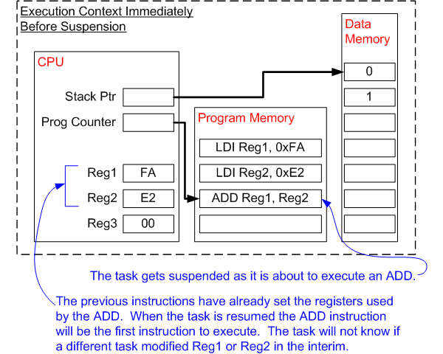
Context Switching
All tasks have their own stack
Notes:
The operating system kernel is responsible for ensuring this is the case - and does so by saving the context of a task as it is suspended. When the task is resumed its saved context is restored by the operating system kernel prior to its execution.

Slide 9
Context related Terms
Context of a Task: All the information needed to be restored so that a task can be restarted this includes:
Program Counter
Status Register
Working Registers
Stack Pointers values
Context Switching: The action of saving the context of one task and restoring the context of another task.
Latency: The time it takes to do context switching

Slide 10
RTOS Tick
The RTOS kernel needs to know time in order to allow some tasks to sleep and one task to have a time slice for a certain duration.
A timer is setup with an ISR to keep track of time.
The ISR will increment a counter, the tick variable, so time between events can be tracked.
A task executing can be interrupted by the timer and then preempted if needed.

Slide 11
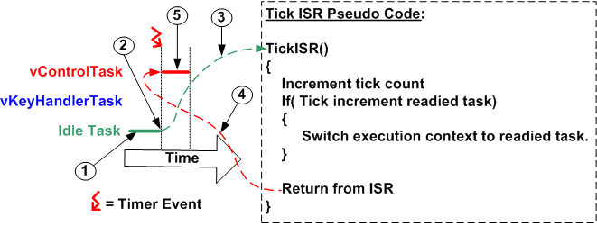
RTOS Tick Preemptive Example
Notes:
At (1) the RTOS idle task is executing.
At (2) the RTOS tick occurs, and control transfers to the tick ISR (3).
The RTOS tick ISR makes vControlTask ready to run, and as vControlTask has a higher priority than the RTOS idle task, switches the context to that of vControlTask.
As the execution context is now that of vControlTask, exiting the ISR (4) returns control to vControlTask, which starts executing (5)

Slide 12
Prioritized Preemptive Scheduling
Preemptive Scheduler – Will only let a task execute for a predefined time quantum or tick and then re-evaluate for the highest priority ready task. It will preempt the current task if a higher priority task is ready.
To understand this policy we must define:
Task states
Task types
Priority changing policy

Slide 13
Task State
Running
Ready
Blocked
Suspended
At any instance only one Task can be running
All other tasks are either ready to run, blocked, or suspended
Notes:
Other names used for task states:
Ready or eligible
Blocked, waiting or delayed
Suspended, stopped, or dorment

Slide 14
Type of Tasks
Idle task – runs at the lowest priority, when no other tasks are ready
Event Driven task – Most of the time in the blocked state waiting for an event to occur. Can be high or low priority
High limits switch is true
Low button is being pressed

Slide 15
Type of Tasks
Periodic task – needs to run and complete in a certain period.
Continuous processing task – never block or suspend themselves.
Limited usefulness because they can only be created at the lowest priority.
Notes:
If a continuous task runs at any other priority than the lowest will starve all tasks of a lower priority

Slide 16
State Transition of Tasks
Notes:
What would cause going into the blocked state? – waiting for and event like a button push or a limit switch activation or waiting for a time event (certain amount of time passing) to occur.
Suspended tasks are not available to the scheduler. They enter that state by an API call and then active or exit also by an API call.
Tasks can be created and destroyed at will by other tasks.

Slide 17
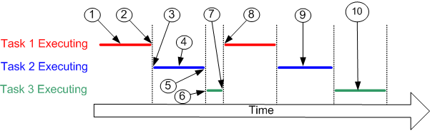
Example of Tasks in the Blocked State
A task can suspend itself (7) by delaying or sleeping for a fixed period of time, or by waiting or blocking until a resource becomes available or some eternal event occurs.
Notes:
At (1) task 1 is executing.
At (2) the kernel suspends task 1 ...
... and at (3) resumes task 2.
While task 2 is executing (4), it locks a processor peripheral for it's own exclusive access.
At (5) the kernel suspends task 2 ...
... and at (6) resumes task 3.
Task 3 tries to access the same processor peripheral, finding it locked task 3 cannot continue so suspends itself at (7).
At (8) the kernel resumes task 1.
Etc.
The next time task 2 is executing (9) it finishes with the processor peripheral and unlocks it.
The next time task 3 is executing (10) it finds it can now access the processor peripheral and this time executes until suspended by the kernel.

Slide 18
Blocked State
Entered waiting for a synchronization event
External event like sensor activation
Internal event like completion of another tasks analysis
Waiting for a peripheral that is being used by another task.
Entered waiting for a temporal event
A delay period expiring
An absolute time being reached

Slide 19
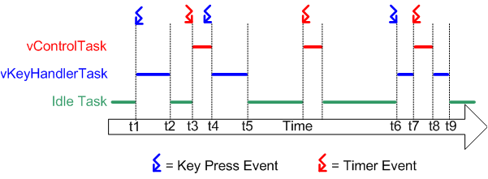
RTOS Preemptive Scheduling Example
Notes:
Referring to the diagram above:
At the start neither of our two tasks are able to run - vControlTask is waiting for the correct time to start a new control cycle and vKeyHandlerTask is waiting for a key to be pressed. Processor time is given to the RTOS idle task.
At time t1, a key press occurs. vKeyHandlerTask is now able to execute - it has a higher priority than the RTOS idle task so is given processor time.
At time t2 vKeyHandlerTask has completed processing the key and updating the LCD. It cannot continue until another key has been pressed so suspends itself and the RTOS idle task is again resumed.
At time t3 a timer event indicates that it is time to perform the next control cycle. vControlTask can now execute and as the highest priority task is scheduled processor time immediately.
Between time t3 and t4, while vControlTask is still executing, a key press occurs. vKeyHandlerTask is now able to execute, but as it has a lower priority than vControlTask it is not scheduled any processor time.
At t4 vControlTask completes processing the control cycle and cannot restart until the next timer event - it suspends itself. vKeyHandlerTask is now the task with the highest priority that is able to run so is scheduled processor time in order to process the previous key press.
At t5 the key press has been processed, and vKeyHandlerTask suspends itself to wait for the next key event. Again neither of our tasks are able to execute and the RTOS idle task is scheduled processor time.
Between t5 and t6 a timer event is processed, but no further key presses occur.
The next key press occurs at time t6, but before vKeyHandlerTask has completed processing the key a timer event occurs. Now both tasks are able to execute. As vControlTask has the higher priority vKeyHandlerTask is suspended before it has completed processing the key, and vControlTask is scheduled processor time.
At t8 vControlTask completes processing the control cycle and suspends itself to wait for the next. vKeyHandlerTask is again the highest priority task that is able to run so is scheduled processor time so the key press processing can be completed.

Slide 20
Scheduling Algorithms – Priority
Fixed Priority – The kernel can not change the priority of a task
Dynamic Priority – The kernel can change the priority on the fly. For example aging of waiting tasks could cause them to increase in priority.

Slide 21
Why Cooperative Policy
Cooperative is the antithesis of preemptive why do it?
Context savings is not needed
Less RAM needed
Many small 8 bit microprocessors do not have much RAM (16F84A has 68 bytes!)
BUT cooperative scheduling is not as responsive as preemptive scheduling.
Salvo is cooperative

Slide 22
RTOS Tasks For Preemptive Policy
Each Task is a small program in its own right
Implemented as a function, can call other common functions but not other tasks
It has an entry point
Normally runs forever in an infinite loop
Tasks should never execute the return statement and should never reach the ending bracket of the function
That is not to say that you can not end and delete a task
Notes:
If the RTOS is preemptive you must write the task so it can be stopped anywhere.

Slide 23
Interrupts and RTOS
The ISR should not be tasks
The ISR can set signals to unblock processes.
The timer tick is usually and ISR.
Taking a ‘long’ time in an ISR can destroy real time performance.

Slide 24
Semaphore and Queues
The RTOS will provide queues for message passing between tasks.
Semaphores are signals that state if something is a ‘go’ or not.
Can be used to lock out peripherals for use by a task
Can be set by interrupts in order to drive event driven tasks.

Slide 25
Task Time Requirement
Period of a process: a repeating time interval during which that process has to execute at least once.
Execution deadline: the time before which a process must run to completion.
Notes:
Period might be screen refresh rate that must be kept.
In the case of execution deadline it does not talk about how often something should be checked it defines how much time a process has to complete once it is started. A task can have both a period and an execution deadline.

Slide 26
How to Determine Priority?
One way is to assign the highest priority to the most frequent (i.e. smallest period) task, called rate monotonic scheduling
Another way is to assign the higher priority to the task that has the tightest (least time) deadline, called deadline monotonic scheduling
Consider: both rate and deadline in making priorities

Slide 27
Task Architecture
It should be a goal to keep the number of tasks to a minimum
One task per deadline
Tasks that are closely related in function and interchange a large amount of data should be made into one task.

Slide 28
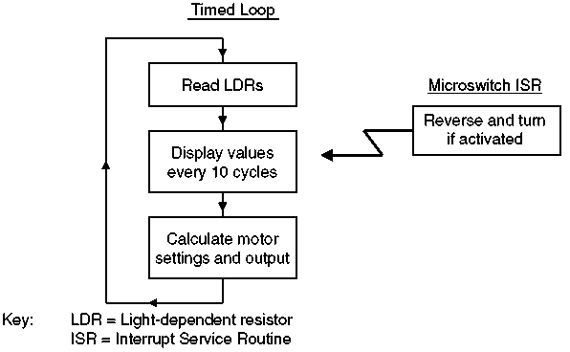
Task Assignment Example
Read LDRs could be combined with motor settings and output
Tasks might be reduced to 3

Slide 29
FreeRTOS
This is free open source code that can be found at freertos.org
It is made for small to midsize processors of:
32 to 512 kbytes of ROM
16 to 256 kbytes or RAM
FreeRTOS is a real time kernel or scheduler on top of which embedded applications can be built to meet hard real time requirements
Notes:
dsPIC33 has 256 K ROM, and 30 k of RAM.

Slide 30
Commercial Application
FreeRTOS can be commercially used in products under a modified GNU General Purpose License (GPL) with the provision that any modification to FreeRTOS is open source code, and you state to every customer that you are using FreeRTOS. The code is royalty free and has no warranty.
The rest of the code as long as it uses just the provided API is still closed source.
Other versions are for sale if you don’t want any open source, state that your using it, or want support.

